Slide 1
CHAPTER
23
Measuring a
Nation’s Income
Notes:
It would be helpful to have your students bring their calculators to class for this chapter so they can practice calculating real and nominal GDP and so forth.
This is the first purely macro chapter in the textbook. It covers the definition of GDP, the spending components of GDP, real vs. nominal GDP, the GDP deflator, and why GDP is a useful but not perfect measure of a nation’s well-being.

Slide 2
Look for the answers to these questions:
What is Gross Domestic Product (GDP)?
How is GDP related to a nation’s total income and spending?
What are the components of GDP?
How is GDP corrected for inflation?
Does GDP measure society’s well-being?

Slide 3
Economics
Microeconomics
Study of how households and firms
Make decisions
Interact in markets
Macroeconomics
Study of economy-wide phenomena
Including inflation, unemployment, and economic growth
Notes:
This is the first strictly macro chapter of the textbook, so it’s worth spending a moment emphasizing the difference between microeconomics and macroeconomics.
Examples of questions that microeconomics seeks to answer:
How do consumers decide how much of each good to buy?
How do firms decide how much output to produce and what price to charge?
What determines the price and quantity of individual goods and services?
How do taxes on specific goods and services affect the allocation of resources?
Examples of questions that macroeconomics seeks to answer:
How do consumers decide how to divide their income between spending and saving?
What determines the total amount of employment and unemployment?
What determines the overall level of prices and the rate of inflation?
Why does the economy go through cycles, where things are great for a few years (like the late ’90s) and then lousy for a year or two (like 2001–2002)?
When unemployment is high, what can the government do to help?
We begin our study of macroeconomics with income and expenditure….

Slide 4
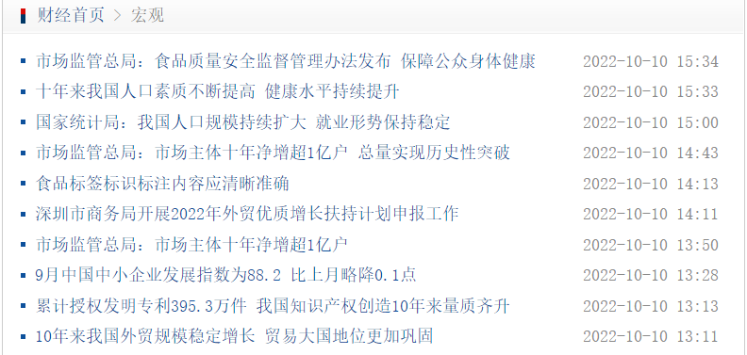
Macro Economic News

Slide 5

1934年南开指数

Slide 6
Why do we care about GDP?
Gross Domestic Product (GDP)
the performance of the economy
Measure the economic well-being of a society
Look at the total income that everyone in the economy is earning

Slide 7
Income and Expenditure
Measure both two at once:
Measures total income of everyone in the economy.
Also measures total expenditure on the economy’s output of goods and services.
Income equals expenditure (why)
For the economy as a whole
Because every dollar a buyer spends is a dollar of income for the seller.
Notes:
The text in the first bullet point is NOT the formal textbook definition of GDP. The formal definition is given and discussed in detail immediately after the Circular-Flow Diagram.
A good way to judge how well someone is doing economically is to look at his or her income. We can judge how well a country is doing economically by looking at the total income that everyone in the economy is earning. GDP is our measure of the economy’s total income, often called “national income.”
GDP also measures total expenditure on the goods and services produced in the economy, and the value of the economy’s output (production) of goods and services. Thus, GDP is also referred to as “output.”
The equality of income and expenditure is an accounting identity (not, for example, an equilibrium condition): it must be true that income equals expenditure.

Slide 8
A case of “income=expenditure”
Karan→Daug 100$
Daug→Karan Mow her lawn
Karan’s expenditure
= Daug’s income

Slide 9
The Circular-Flow Diagram 循环流量图
The Circular-Flow Diagram(page5)
Simple depiction of the macroeconomy
Illustrates GDP as spending, revenue, factor payments, and income
Preliminaries:
Factors of production are inputs like labor, land, capital, and natural resources.
Factor payments are payments to the factors of production (e.g., wages, rent).
Notes:
If your students already know the terms “factors of production” and “factor payments,” you may wish to delete the “preliminaries” from this slide.

Slide 10
The Circular-Flow Diagram
Households:
own the factors of production, sell/rent them to firms for income
buy and consume goods & services
Firms
Households
Firms:
buy/hire factors of production, use them to produce goods and services
sell goods & services
Notes:
10
This and the following slide build the Circular-Flow Diagram piece by piece.

Slide 11
The Circular-Flow Diagram
Revenue (=GDP)
Spending (=GDP)
Markets for Goods & Services
G & S sold
G & S bought
Firms
Households
Factors of production
Labor, land, capital
Markets for Factors of Production
Wages, rent, profit (=GDP)
Income (=GDP)
Notes:
11
In this diagram, the green arrows represent flows of income/payments. The red arrows represent flows of goods & services (G&S) (including services of the factors of production in the lower half of the diagram).
To keep the graph simple, we have omitted the government, financial system, and foreign sector, as discussed on the next slide.
Changing the animation on this slide:
If you wish, you can easily change the order in which the markets and arrows appear. From the “Slide Show” drop-down menu, choose “Custom Animation…” Then, a box will appear (maybe along the right-hand-side of your PowerPoint window) that allows you to modify the order in which things appear (as well as other aspects of the animation). For further information, open PowerPoint help and search on “change the sequence of animations.”

Slide 12
GDP Measures the flow
Two ways:
Adding up the expenditure by household.
(from goods and services markets)
2. Adding up total income paid by firms.
(from production factor markets)
GDP IS THE SAME regardless of how we compute it!

Slide 13
What This Diagram Omits
The government
Collects taxes, buys goods and services
The financial system
Matches savers’ supply of funds with borrowers’ demand for loans
The foreign sector
Trades goods and services, financial assets, and currencies with the country’s residents
Notes:
In future chapters, we will study the role of each of these in greater detail.
We could draw a more complicated circular flow diagram that includes the government, financial system, and foreign sector. Including them, however, would not change the basic conclusion that GDP simultaneously measures the country’s total income, expenditure, revenue, and factor payments.

Slide 14
Gross Domestic Product (GDP) Is… 国内生产总值
…the market value of all final goods & services produced within a country in a given period of time.
You can’t compare apples and oranges.
Goods are valued at their market prices, so:
All goods measured in the same units (e.g., dollars in the U.S.)
Things that don’t have a market value are excluded, e.g., housework you do for yourself.
Notes:
This slide and the six that follow focus on the meaning of each part of this critically important definition.
Note that transactions occurring in the so-called “underground economy” are also omitted from the official measure of GDP.

Slide 15
Gross Domestic Product (GDP) Is…
…the market value of all final goods & services produced within a country in a given period of time.
GDP includes all items produced in the economy and sold legally in markets
GDP excludes most items produced and sold illicitly. It also excludes most items that are produced and consumed at home.
Eg. If Karan and Daug marry, GDP falls even if Daug still mow the lawn for Karan.
Notes:
x

Slide 16
Rental House vs Owner-occupied
The rent of a house is calculated in GDP
But if you live a house you own:
GDP is base on the assumption that you rent it by yourself.
The imputed rent is included in the homeowner’s expenditure and income, so it adds to GDP.
居民购买住房算不算入GDP?

Slide 17
Case Study
Family 1 built a house in 1985 for 90,000 dollars and live in it until 2002. If others rent this house, it costs 10,000 dollars per year. In 2002 they sell the house to family 2 for 175,000 dollars.
1. How much value does it add into GDP in 1985? What if Family bought, not bulit the house?
2. Does this house contrubution to GDP of 2002 rise by 85,000 dollars, rise by 175,000 dollars, or not change at all?

Slide 18
Materials Used for Building is in GDP

Slide 19
Gross Domestic Product (GDP) Is…
…the market value of all final goods & services produced within a country in a given period of time.
Final goods最终产品: intended for the end user
Intermediate goods中间产品: used as components or ingredients in the production of other goods
GDP only includes final goods—they already embody the value of the intermediate goods used in their production.
Notes:
x

Slide 20
Exception: inventory存货
When an intermediate good is produced and, rather than being used, is added to a firm’s inventory of goods for use or sale at a later date.
In this case, the intermediate good is taken to be “final” as inventory investment for the moment.
When it is used or sold, the inventory investment is negative, and GDP will fall.

Slide 21
Intermediate vs Final

Slide 22
Gross Domestic Product (GDP) Is…
…the market value of all final goods & services produced within a country in a given period of time.
GDP includes tangible goods (like cell phone, mountain bikes, beer)
and intangible services (dry cleaning, concerts, cell phone service).
Notes:
x

Slide 23
Gross Domestic Product (GDP) Is…
…the market value of all final goods & services produced within a country in a given period of time.
GDP includes currently produced goods, not goods produced in the past.
Eg. When GE produces and sells a car for $30,000, its value is included in GDP. When the used car is sold at $35,000, this money is not included.

Slide 24
Gross Domestic Product (GDP) Is…
…the market value of all final goods & services produced within a country in a given period of time.
GDP measures the value of production that occurs within a country’s borders, whether done by its own citizens or by foreigners located there.
Gross national product (GNP，国民生产总值）is the market value of all the products and services produced by the citizens of a country.

Slide 25
Gross Domestic Product (GDP) Is…
…the market value of all final goods & services produced within a country in a given period of time.
Usually a year or a quarter (3 months)
Seasonal adjustment季节性调整
removing seasonal factor to analyse the trend, and cyclical deviations from trend.

Slide 26
Exercises
Page26
Question For Review复习题
1.
2.
3.
4.

Slide 27
The Components of GDP
Recall: GDP is total spending支出
（支出法、生产法、收入法）
Spending has many forms:
Smith buys a lunch at Burger King;C
GE builds a factory;I
Navy procures a submarine;G
British Airways buys an airplane from Boeing;NE
These are spent on domestically produced goods and services.
(包括外国人购买本国的支出)
Notes:
Each of the four components is defined and discussed in detail on the following slides.

Slide 28
The Components of GDP
Four components:
Consumption (C)消费
Investment (I)投资
Government Purchases (G)政府购买
Net Exports (NX)净出口
These components add up to GDP (denoted Y): Y = C + I + G + NX

Slide 29
Consumption (C)
Consumption, C
Total spending by households on goods and services
Durable goods: automobiles and appliances
Nondurable goods: food and clothing
Services: haircuts and medical care, renting a house
Buy stocks?
Notes:
Mostly, the term “consumption” refers to what students probably already think of as total consumer spending. The note about the treatment of owner-occupied housing is an exception, and some of the test bank questions are designed to see if students remember this exception.
(For more on this issue, see the notes accompanying the following slide.)

Slide 30
Exception: Buying New House
Note on housing costs:
For renters, C includes rent payments.
For homeowners, C includes the imputed rental value of the house, but not the purchase price or mortgage payments
Not included in C: purchases of new housing
But included as I in GDP

Slide 31
Investment (I)
Investment, I
Total spending on goods that will be used in the future to produce more goods
Business capital: business buildings, equipment, and intellectual property products
Residential capital: landlord’s apartment building; a homeowner’s personal residence
Inventory accumulations: goods produced but not yet sold
“Investment” does not mean the purchase of financial assets like stocks and bonds.
Notes:
More on the treatment of owner-occupied housing:
In the national income and product accounts, a house is considered a piece of capital that is used to produce a flow of services—housing services.
When a consumer (as a tenant) rents a house or apartment, the consumer is buying housing services. These services are considered consumption, so the price paid for these services – rent – is counted in the “consumption” component of GDP .
When someone buys a new house to live in, she is both a producer and a consumer. As a producer, she has made an investment (the purchase of the house) that will produce a service. She is also the consumer of this service, which is valued at the market rental rate for that type of house. So, the accounting conventions treat this situation as if the person is her own landlord and rents the house to/from herself.
When students begin to understand this, they may wonder why certain other goods (like cars) that produce a flow of consumer services are not also treated this way. There really is no good answer. It’s just a convention of the national income and product accounts.

Slide 32
A Case of Inventory Accumulation 存货积累
IBM produced a computer, not selling it, but added it to its inventory.
IBM’s investment spending will increase this period.
When later IBM sells the computer out of inventory, IBM’s investment spending will be negative, offsetting the buyer’s spending.
C and I offsets, no increase of GDP.

Slide 33
Government Purchases (G)
Government purchases (G)
All spending on the goods and services purchased by the government
At the federal, state, and local levels.
政府消费支出和总投资
Excludes transfer payments转移支付不算
Such as Social Security or unemployment insurance benefits.
They are not purchases of goods and services
Notes:
You might tell your students that transfer payments, like Social Security checks, are excluded from G to avoid double-counting: retired persons spend part or all of their Social Security benefits on food, rent, prescriptions, and so forth, all of which count in consumption. If we also counted the Social Security check as part of G, then the same money would be counted twice, which would make GDP look bigger than it really is.

Slide 34
Net Exports (NX)
Net exports, NX = exports – imports
Exports: foreign spending on the economy’s goods and services
Imports: are the portions of C, I, and G that are spent on goods and services produced abroad
Adding up all the components of GDP gives:
Y = C + I + G + Export-Import
Notes:
The “net” in “net exports” refers to the fact that we are subtracting imports from exports. This subtraction is important, because imports are also counted in the other components of GDP; failing to subtract them would cause GDP to measure not just the value of goods produced domestically, but also goods produced abroad and imported.
For example, if a consumer spends $100 on a DVD player imported from Japan, that $100 counts in “consumption,” even though the player was not produced domestically. We subtract off that $100 import so that GDP ends up including the value of only domestically-produced goods and services.

Slide 35
U.S. GDP and Its Components, 2015
 | Billions | % of GDP | Per capita
Y | $17,947 | 100.0 | $55,426
C | 12,272 | 68.4 | 37,899
I | 3,021 | 16.8 | 9,330
G | 3,183 | 17.7 | 9,830
NX | -529 | -2.9 | -1,634
Notes:
An updated version of Table 1 in this chapter of the textbook.
Source for data on GDP & components: https://fred.stlouisfed.org/series/PCECA: Table 1.1.5
Source for population data (used to calculate the per capita figures): http://research.stlouisfed.org/fred2/series/POPTHM?cid=104 (
Original source: U.S. Department of Commerce: Census Bureau, www.census.gov

Slide 36
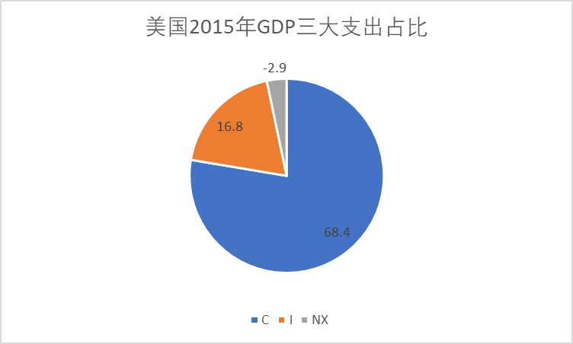
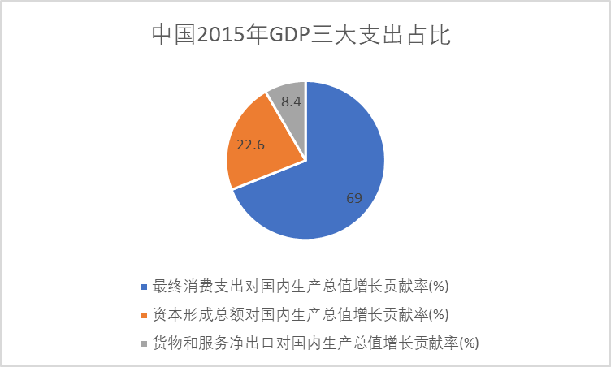
2015年中美GDP三大需求支出占比

Slide 37
Active Learning 1 GDP and its components
In each of the following cases, determine how much GDP and each of its components is affected (if at all).
Debbie spends $300 to buy her husband dinner at the finest restaurant in Boston.
Sarah spends $1200 on a new laptop to use in her publishing business. The laptop was built in China.
Jane spends $800 on a computer to use in her editing business. She got last year’s model on sale for a great price from a local manufacturer.
General Motors builds $500 million worth of cars, but consumers only buy $470 million worth of them.
Notes:
Suggestion: Show these questions, and give your students 1–3 minutes to formulate their answers.
Ask for someone to volunteer his or her response. Then show the answers on the next two slides.

Slide 38
Purpose of Real GDP
Spending rises when:
A larger output of goods and services
Higher prices
Economists want a measure of total quantity of goods and services, not affected by changes of prices.
Real GDP shows how production of goods and services changes over time, removing price changes.

Slide 39
Real versus Nominal GDP
Nominal GDP
Values output using current prices
Not corrected for inflation
Real GDP
Values output using the prices of a base year
Is corrected for inflation
For the base year
Nominal GDP = Real GDP
Specific year
in the past
Notes:
Because inflation can distort economic variables like GDP, we have two versions of GDP.

Slide 40
EXAMPLE:
Compute nominal GDP in each year:
2014: $10 x 400 + $2 x 1000 = $6,000
2015: $11 x 500 + $2.50 x 1100 = $8,250
2016: $12 x 600 + $3 x 1200 = $10,800
Increase:
37.5%
30.9%
 | Pizza |  | Latte
year | P | Q | P | Q
2014 | $10 | 400 | $2.00 | 1000
2015 | $11 | 500 | $2.50 | 1100
2016 | $12 | 600 | $3.00 | 1200
Notes:
40
This example is similar to that in the text, but using different goods and different numerical values.
Suggestion: Ask your students to compute nominal GDP in each year before revealing the answers. Ask them to compute the rate of increase before revealing the answers.
In this example, nominal GDP grows for two reasons: prices are rising, and the economy is producing a larger quantity of goods.
Thinking of nominal GDP as total income, the increases in income will overstate the increases in society’s well-being because part of these increases are due to inflation.
We need a way to take out the effects of inflation, to see how much people’s incomes are growing in purchasing power terms. That is the job of real GDP.

Slide 41
EXAMPLE:
Compute real GDP in each year, using 2014 as the base year:
2014: $10 x 400 + $2 x 1000 = $6,000
2015: $10 x 500 + $2 x 1100 = $7,200
2016: $10 x 600 + $2 x 1200 = $8,400
 | Pizza |  | Latte
year | P | Q | P | Q
2014 | $10 | 400 | $2.00 | 1000
2015 | $11 | 500 | $2.50 | 1100
2016 | $12 | 600 | $3.00 | 1200
$10
$2.00
Increase:
20.0%
16.7%
Notes:
41
This example shows that real GDP in every year is constructed using the prices of the base year and that the base year doesn’t change.
The growth rate of real GDP from one year to the next is the answer to this question:
“How much would GDP (and hence everyone’s income) have grown if there had been zero inflation?”
Thus, real GDP is corrected for inflation.

Slide 42
EXAMPLE:
year | Nominal GDP |  | Real GDP
2014 | $6000 |  | $6000
2015 | $8250 |  | $7200
2016 | $10,800 |  | $8400
In each year,
nominal GDP is measured using the (then) current prices.
real GDP is measured using constant prices from the base year (2014 in this example).
Notes:
42
The table in the top half of this slide merely summarizes the answers from the previous two slides. This table will be used shortly to compute the growth rates in nominal and real GDP and to compute the GDP deflator and inflation rates.

Slide 43
EXAMPLE:
The change in nominal GDP reflects both prices and quantities.
The change in real GDP is the amount that GDP would change if prices were constant (i.e., if zero inflation).
Hence, real GDP is corrected for inflation.
year | Nominal GDP |  | Real GDP
2014 | $6000 |  | $6000
2015 | $8250 |  | $7200
2016 | $10,800 |  | $8400
37.5%
20.0%
30.9%
16.7%
Notes:
43
Again, the growth rate of real GDP from one year to the next is the answer to this question:
“How much would GDP (and hence everyone’s income) have grown if there had been zero inflation?”
This is why real GDP is corrected for inflation.

Slide 44
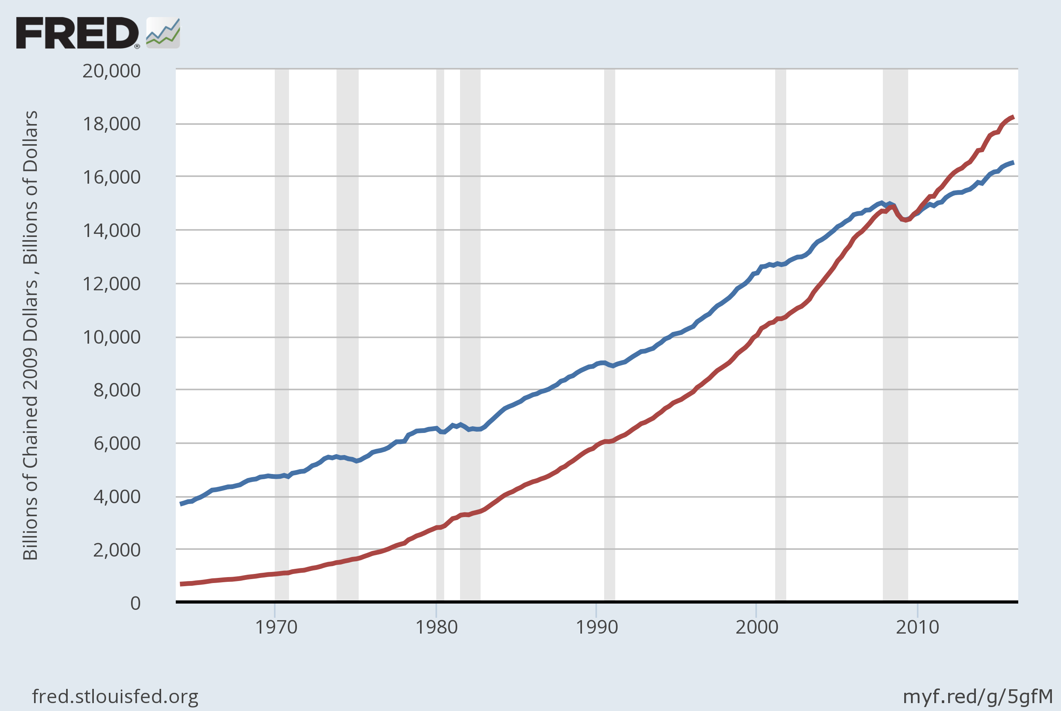
Nominal and Real GDP in the U.S., 1965–2015
Real GDP (base year 2009)
Nominal GDP
Notes:
Since you have just finished covering real vs. nominal GDP, it might be worthwhile pointing out the following to your students:
The graph shows that nominal GDP rises faster than real GDP. This should make sense, because growth in nominal GDP is driven by growth in output AND by inflation. Growth in real GDP is driven only by growth in output.
The two lines cross in the year 2009 (the base year for the real GDP data in this graph). This should make sense because real GDP equals nominal GDP in the base year. (Better yet, ask your students whether there’s anything significant about the point where the two lines cross.)
Before the base year, real GDP > nominal GDP. For example, in 1981, nominal GDP is about $3 trillion, while real GDP is about $6 trillion (in 2009 dollars). This should make sense because prices were so much higher in 2009 than in 1981, so using those high 2009 prices to value 1981 output would lead to a bigger result than valuing 1981 output using 1981 prices.
Similarly, after 2009, nominal GDP is higher than real GDP because prices are higher in later years than they were in 2009.
The original source: U.S. Department of Commerce: Bureau of Economic Analysis
Source: US. Bureau of Economic Analysis, retrieved from FRED, Federal Reserve Bank of St. Louis
Real Gross Domestic Product [GDPC1]; https://fred.stlouisfed.org/series/GDPC1, July 7, 2016. Gross Domestic Product [GDP], https://fred.stlouisfed.org/series/GDP, July 7, 2016.

Slide 45
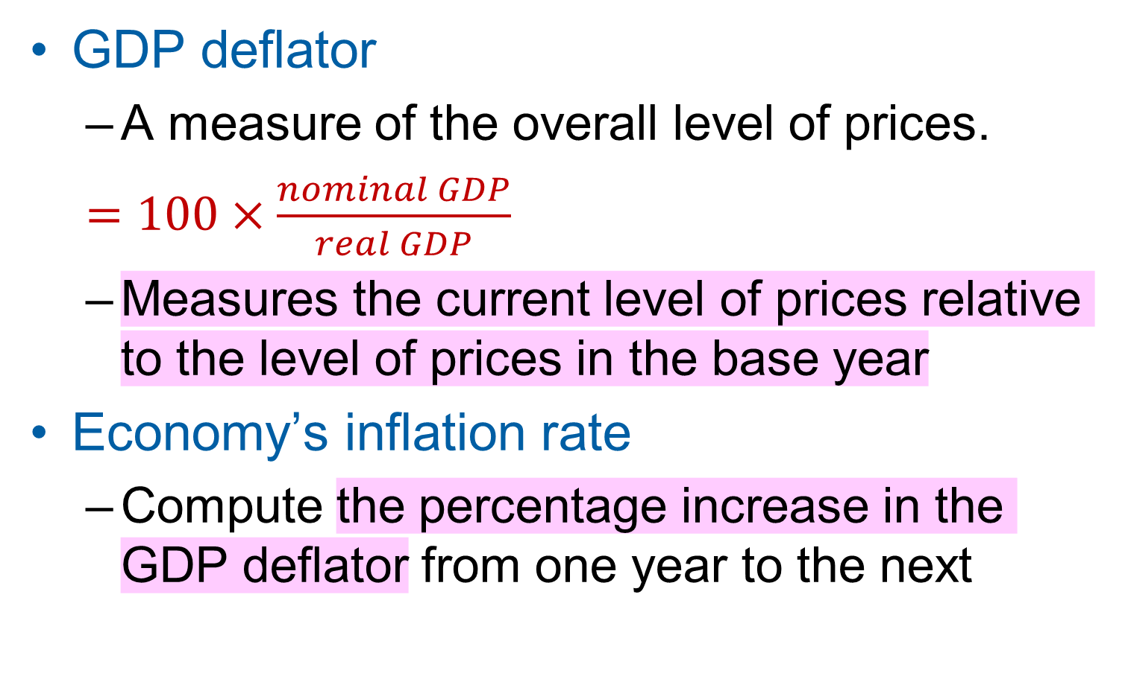
The GDP Deflator GDP平减指数
GDP deflator
A measure of the overall level of prices.
$=100×\frac{nominal GDP}{real GDP}$
Measures the current level of prices relative to the level of prices in the base year
Economy’s inflation rate
Compute the percentage increase in the GDP deflator from one year to the next
GDP平减指数>100可以反映物价水平的上涨吗？
Notes:
The GDP Deflator gets its name because it is used to “deflate” (i.e., take the inflation out of) nominal GDP to get real GDP.
For the base year, the GDP deflator is 100.

Slide 46
EXAMPLE:
Compute the GDP deflator in each year:
2014: 100 x (6000/6000) = 100
2015: 100 x (8250/7200) = 114.6
2016: 100 x (10,800/8400) = 128.6
year | Nominal GDP | Real GDP | GDP Deflator
2014 | $6000 | $6000
2015 | $8250 | $7200
2016 | $10,800 | $8400
100.0
14.6%
114.6
12.2%
128.6
Notes:
46

Slide 47
EXAMPLE:
Compare nominal GDP, real GDP and GDP deflator:
37.5%≠20.0%+14.6%
30.9%≠16.7%+12.2%
year | Nominal GDP |  | Real GDP | GDP Deflator
2014 | $6000 |  | $6000 | 100.0
2015 | $8250 |  | $7200 | 114.6
2016 | $10,800 |  | $8400 | 128.6
37.5%
20.0%
14.6%
30.9%
16.7%
12.2%
Notes:
47
Again, the growth rate of real GDP from one year to the next is the answer to this question:
“How much would GDP (and hence everyone’s income) have grown if there had been zero inflation?”
This is why real GDP is corrected for inflation.

Slide 48
Active Learning 2 Computing GDP
 | 2014 (base year) |  | 2015 |  | 2016
 | P | Q | P | Q | P | Q
Good A | $30 | 900 | $31 | 1000 | $36 | 1050
Good B | $100 | 192 | $102 | 200 | $100 | 205
Use the above data to solve these problems:
Compute nominal GDP in 2014.
Compute real GDP in 2015.
Compute the GDP deflator in 2016.
Notes:
The data in the table are for a hypothetical economy that produces two final goods, A and B. For all parts of this problem, use 2014 as the base year.
If you’re running short on time, you can skip part A—it’s the least challenging. If you only have time for one of the three, you might skip A and B, as C by itself covers all of the material: it requires students to compute nominal and real GDP before they can compute the GDP deflator.

Slide 49
Is GDP a good measure of Economic Well-Being?
Real GDP reflects well-being better than nominal GDP （剔除价格的泡沫）
Real GDP per capita
Main indicator of the average person’s standard of living
But GDP is not a perfect measure of well-being.
Robert Kennedy issued a very eloquent yet harsh criticism of GDP:
Notes:
Most economists, policymakers, social scientists, and businesspersons use a country’s real GDP per capita as the main indicator of the average person’s standard of living in that country.

Slide 50
Senator Robert Kennedy, 1968 Gross Domestic Product…
“… does not allow for the health of our children, the quality of their education, or the joy of their play.
It does not include the beauty of our poetry or the strength of our marriages, the intelligence of our public debate or the integrity of our public officials.
It measures neither our courage, nor our wisdom, nor our devotion to our country.
It measures everything, in short, except that which makes life worthwhile, and it can tell us everything about America except why we are proud that we are Americans.”
Notes:
Very scathing words, indeed!

Slide 51
Mankiw’s Correction
GDP does not directly measure those things that make life worthwhile, but it does measure our ability to obtain the inputs into a worthwhile life:
Better healthcare
Better educational system
More citizens to read and enjoy the poetry

Slide 52
GDP Does Not Value:
The quality of the environment
Leisure time
Non-market activity, such as the child care a parent provides at home
An equitable distribution of income
It is important to keep in mind what GDP includes and what it leaves out.
Notes:
Much of what Robert Kennedy said about GDP is correct.

Slide 53
Then Why Do We Care About GDP?
Having a large GDP enables a country to afford
Better schools, a cleaner environment, health care, etc.
Many indicators of the quality of life are positively correlated with GDP. For example…
Notes:
Then why do we care about GDP?
Because a large GDP does in fact help us to lead a good life. GDP does not measure the health of our children, but nations with larger GDP can afford better health care for their children. GDP does not measure the beauty of our poetry, but nations with larger GDP can afford to teach more of their citizens to read and enjoy poetry. GDP does not take account of our intelligence, integrity, courage, wisdom, or devotion to country, but all of these laudable attributes are easier to foster when people are less concerned about being able to afford the material necessities of life.
In short, GDP does not directly measure those things that make life worthwhile, but it does measure our ability to obtain the inputs into a worthwhile life.

Slide 54
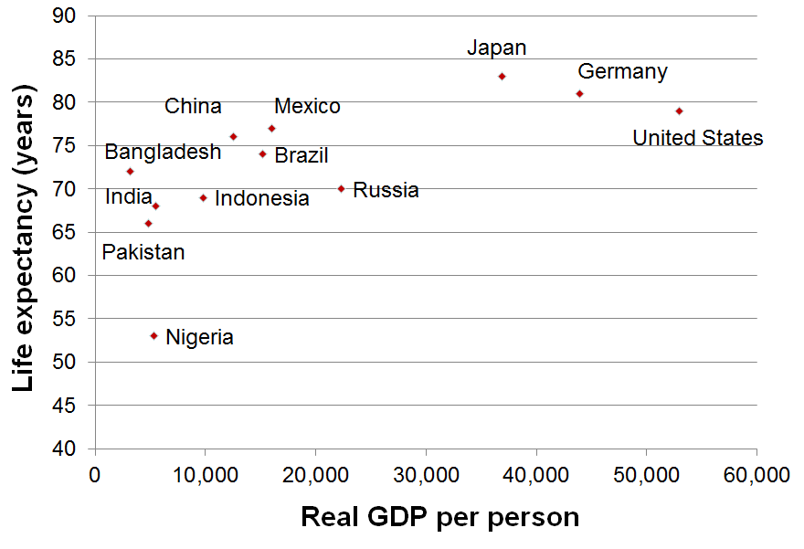
GDP and Life Expectancy in 12 countries
Notes:
This figure and the two that follow are from the data in Table 3 of the textbook.
Real GDP per capita figures are expressed in U.S. dollars.
Source: Human Development Report 2015, United Nations.
Real GDP is for 2014, expressed in 2011 dollars.

Slide 55
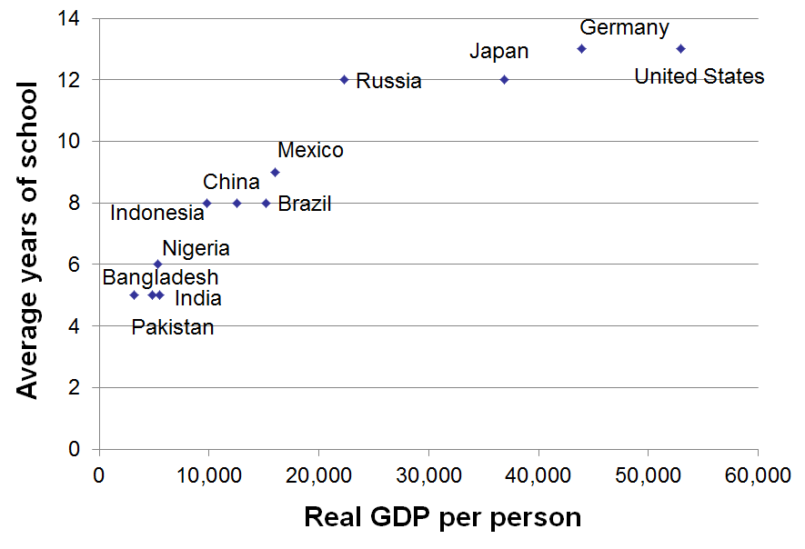
GDP and Average Schooling in 12 countries
Notes:
Source: Human Development Report 2015, United Nations.
Average years of schooling is among adults 25 and older.

Slide 56
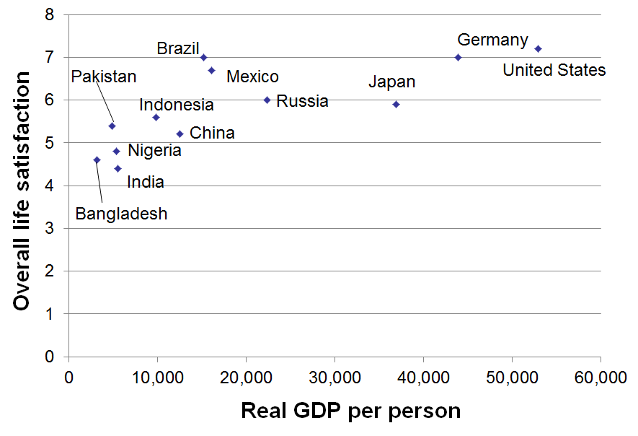
GDP and Overall Life Satisfaction (0 to 10 scale) in 12 countries
Notes:
Source: Human Development Report 2015, United Nations.
Overall life satisfaction on a 0 to 10 scale.

Slide 57
Summary
Gross Domestic Product (GDP) measures a country’s total income and expenditure.
The four spending components of GDP include: Consumption, Investment, Government Purchases, and Net Exports.
Nominal GDP is measured using current prices. Real GDP is measured using the prices of a constant base year and is corrected for inflation.
GDP is the main indicator of a country’s economic well-being, even though it is not perfect.

Slide 58
Exercises
Page27
问题与应用
1
5
7（改为以2009年为基年）

